Slide 1
Team 4a
SuggestGlasgow ☺

Slide 2
SuggestGlasgow - Summary
The objective of our application is to give users random suggestions of places to visit, the four categories are; Cafes, Restaurants, Fast food and Nightlife.
Everyone will be able to get random recommendations of places to visit, view the likes and dislikes of a place, read comments and visit the place's website as well as view where the place is on a map.
Registered users will be able to save places to their own personal lists, like/dislike and comment on any places they have visited. They will also be able to upload new places to the application.

Slide 3

Persona one
Katherine is 27 and is very indecisive so never knows where to go to eat therefore a random recommending system would give her inspiration.
She enjoys going to cafes for lunch with friends, however she has celiac disease so having easy access to the website of the place she's visiting allows her to check menus in advance to see if a coffee place/restaurant will be able to cater to her.
Katherine also likes to visit popular nightlife venues so will be able to choose places to visit based on their likes, dislikes and comments.
Katherine also likes to share places she's been previously with other people.

Slide 4
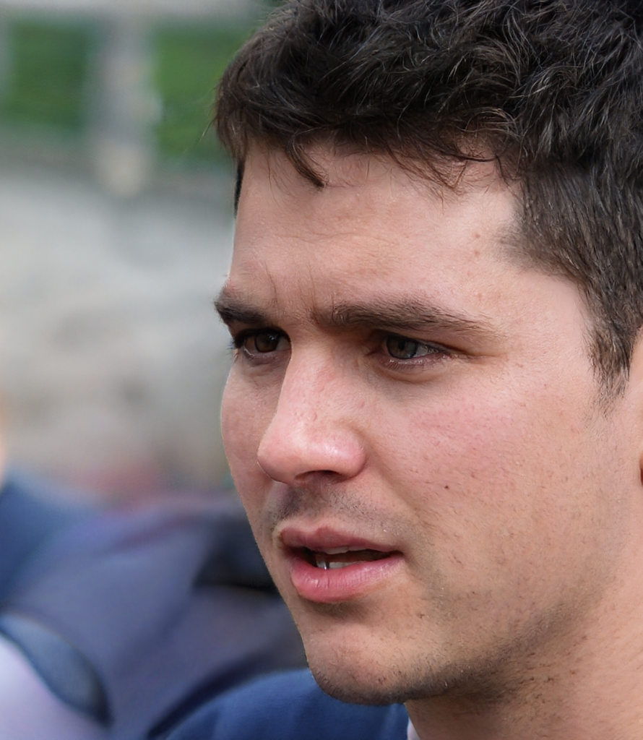
Persona two
Marc is 18 years old, from Belgium and is part of a study abroad scheme studying at University of Glasgow.
He likes to go out with his friends at night to different bars and restaurants.
Him and his friends are new to Glasgow, and they don't know of any good places to go. They usually stay in the bars until late at night and want to make sure the bars have appropriate opening hours by checking their website.
Marc and his friends likes to go to trendy places to share on social media, he likes to see a picture of the place before he visits and he struggles with directions in the new city so a map would be helpful.

Slide 5
Requirements
Users select which category (restaurants, cafes, nightlife, fast food) to get a suggestion for or able to choose to visit any category.
Users get shown a random place.
A place will have a name, a photo, a place on the map, a category type and optionally, a link to their website.
Users can see how many likes and dislikes a place has.
Users can view comments for a place.
Users can sign up.
Registered users can sign in to:
add places to the website
add comments about places
save places to their profile
like places that they enjoyed
dislike places
logout

Slide 6
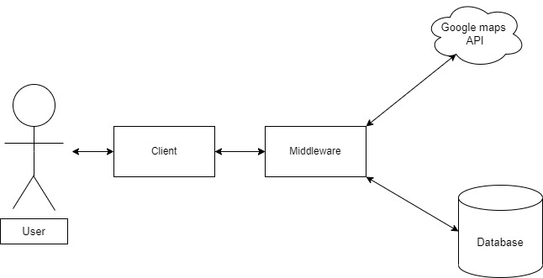
System architecture diagram

Slide 7
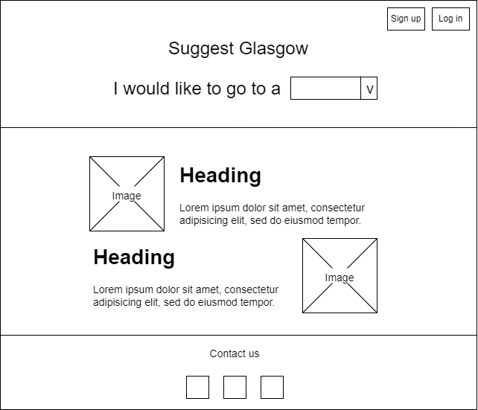
Front page wireframe

Slide 8
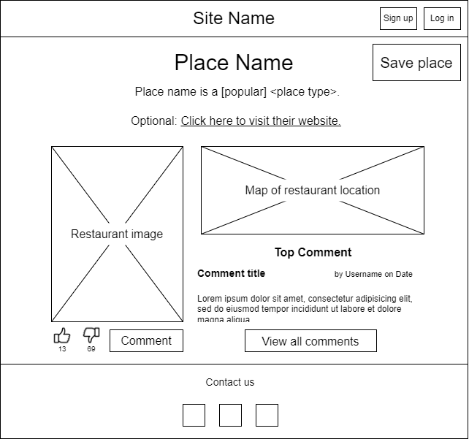
Place page wireframe

Slide 9
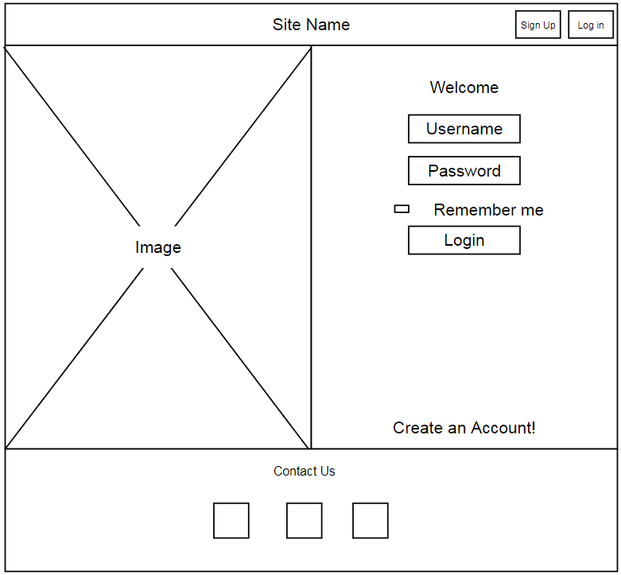
Log in page wireframe

Slide 10
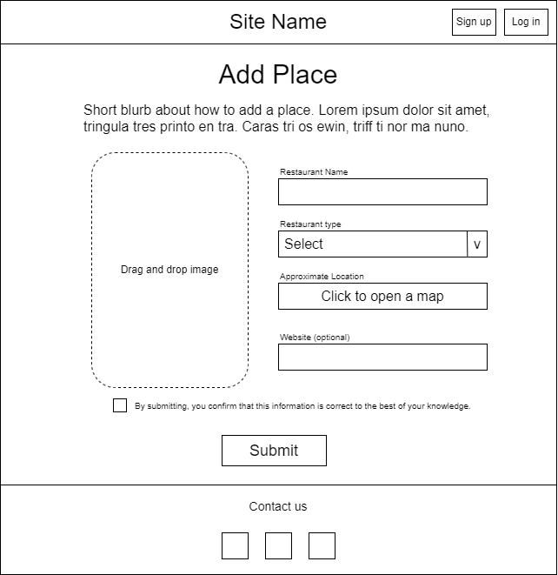
Add place page wireframe

Slide 11
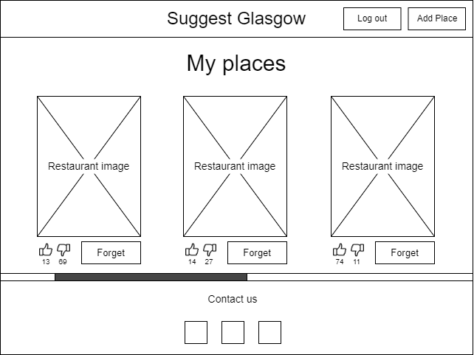
Profile page wireframe

Slide 12
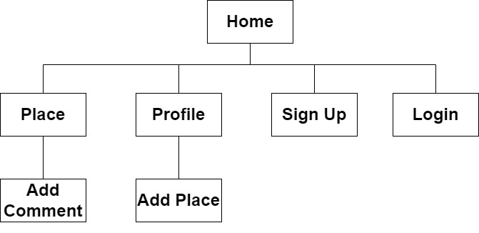
Walkthrough one – sitemap

Slide 13
Walkthrough two - urls
/
/Login/
/SignUp/
/Profile/
/Profile/AddPlace/
/Place/<place name>/
/Place/<place name>/AddComment/

